Slide 1

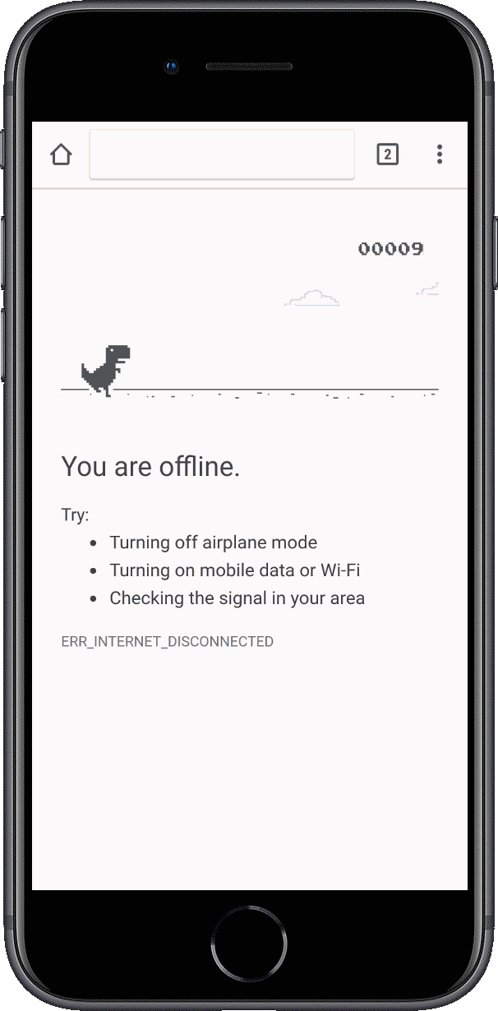
Offline-First
with
Progressive Web Applications
Bob Fornal

Slide 2
PWA: US License Plate Game
Code:
http://bit.ly/uslpg-code
Site:
http://bit.ly/uslpg

Slide 3
Overview
How did we get here?
Thinking Offline-First
What are PWAs and TWAs?
What is a Service Worker?
Purple Pattern?
Web App Manifest
Event-Based Activities (including push)
Lighthouse Audits
Batteries Included
DEMOS ...

Slide 4
How did we get here?
Native Applications
(specific code-bases)
Hybrid Applications
(write => test => build xCode)
(write => test => build Android Studio)
(UX not seamless
Cross-Platform Native
(Xamarin / React Native)
(Need xCode and Android Studio)
Mobile Web
(not mobile application)

Slide 5
Thinking Offline-First
Use a “cache-first strategy.”
BASE EXPERIENCE
STATIC ASSETS
OFFLINE PAGES
BACKGROUND SYNC
PUSH NOTIFICATION

Slide 6
Batteries Included
React
Preact
Polymer
Vue
Angular

Slide 7
What are PWAs and TWAs?
An application that runs without (or with limited) Internet.
Progressive Web Application
Trusted Web Activities
Principles:
Reliable: load instantly, never show Chrome dinosaur.
Fast: no janky animations or scroll.
Engaging: natural with immersive UX.

Slide 8
What is a Service Worker
“Man in the Middle”
Scripts that intercept network requests so developers can treat the network as an enhancement and provide offline experiences for users of web applications.
They have both costs and benefits/
If used recklessly, can make page-loading slower.
Optimize navigation requests to minimize costs.
Manage cache content.
Always respect the user.
Only Under-Scope ...

Slide 9
Updating a Service Worker
The browser tries to reload the Service Worker in the background.
If there is even a single byte difference in the Service Worker file, the browser will assume that there is a change and a new Service Worker has to be started.
The new Service Worker will be started. The old Service Worker is still in control which means that the new Service Worker will enter a waiting state.
Once the currently opened pages of your web app are closed, the old Service Worker will be killed by the browser and the newly-installed Service Worker will take full control.
This avoids the problem of having two versions of a web app running simultaneously.

Slide 10
Caching is HARD
Having two tabs open can be an issue (uses single cache instance).
The application works offline. ALWAYS. Even on localhost ...
Notes:
Storage Quota and Limits … https://www.html5rocks.com/en/tutorials/offline/quota-research/

Slide 11
Purple Pattern (PRPL)
PUSH critical resources for the initial route.
RENDER initial route and get interactive ASAP.
PRE-CACHE remaining routes using Service Worker.
LAZY-LOADING and instantiate remaining routes on-demand.

Slide 12
Web App Manifest
JSON file that tells the browser about the application and how it should behave when “installed” on the user’s device or desktop.

Slide 13
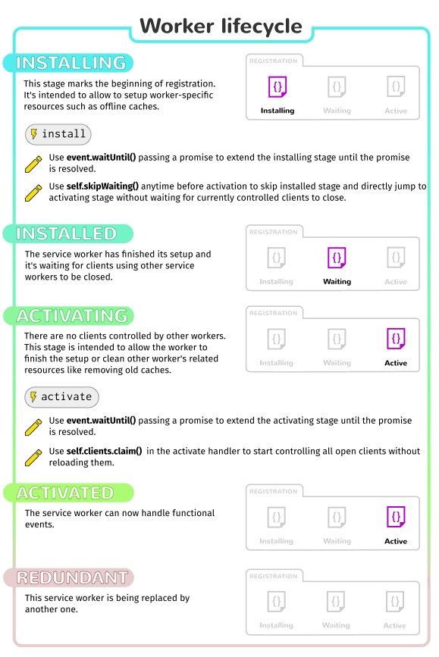
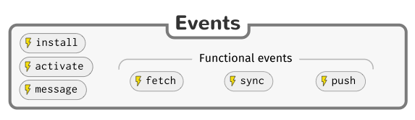
Event-Based Activities

Slide 14
Event-Based Activities
Install triggered as soon as the worker executes; it's only called once per service worker.
Activate once the service worker is ready to control clients and handle functional events.
Fetch an action that contains information about the request and resulting response, which allows us to provide a response back to the page.
Extendable ensures that any functional events (like fetch) are not dispatched until it upgrades database schemas, and deletes outdated cache entries, etc.
Message
Sync

Slide 15
Lighthouse Audits
Chrome Developer Tools
Progressive Web App
12 audits with assistance ...

Slide 16
Working Offline
Sensing Online versus Offline
let online = navigator.onLine;
window.addEventListener(‘online’, () => { this.set(‘online’, true });
window.addEventListener(‘offline’, () => { this.set(‘online’, false });

Slide 17
Working Offline (continued)
Sensing Network Speed
if (‘connection’ in navigator) {
this.updateSpeedIcon(navigator.connection); // ***
navigator.connection.addEventListener(‘change’, (event) => {
this.updateSpeedIcon(event.target);
});
}
***
{
type: ‘wifi’ || ‘cellular’ || ‘bluetooth || …,
downLinkMax: ‘10’, // Mbps
rtt: ‘250’, // Round Trip Time in ms
effectiveType: ‘slow-2g’ || ‘2g’ || ‘3g’ || ‘4g’
}

Slide 18
Sensors
Geosensors
Google Maps Integration
Gyro Sensors
Photo Capture
Audio & Video Capture (vanilla controls)
Camera Discovery & Detection
Network Health, Status, and Speed
Battery Sensing
Vibration API
Local Notifications

Slide 19
Strategies for Offline UX
Static Content / Assets (to boot and be responsive)
Application User Data (JSON)
Each framework has its own preferred tooling.
Local Cache: to store assets …
Fetching Proxy: so remote requests look in local cache first …
Update Mechanism: means to refresh local cache with new remote content ...

Slide 20
Handset Integration
Battery Status API
readBatteryStatus() {
if (‘getBattery’ in navigator) {
navigator.getBattery()
.then((batteryMgr) => {
this.set(‘batterylevel’, batteryMgr.level); ***
});
}
}
***
batteryMrg.onlevelchange
batteryMrg.onchargingchange
batteryMrg.onchargingtimechange
batteryMrg.ondischargingtimechange

Slide 21
Handset Integration (continued)
Vibration API
navigator.vibrate(200); // ms
navigator.vibrate([100, 50, 200, 50]); // on-off-on-off
Local Notifications
(persistent notifications)
PUSH
Local Notifications

Slide 22
Finding Your Location ...
Minimal Geolocation API
navigator.geolocation.getCurrentPosition(
successCallback,
errorCallback,
[options]
);
function successCallback(posn) { … }
function errorCallback(err) { ... }
posn = { accuracy, altitude, altitudeAccuracy, latitude, longitude, heading, speed };
navigator.geolocation.watchPosition
navigator.geolocation.clearWatch(watchId)
… via HTML5.

Slide 23
Geolocation ...
Configuring Geo Options
positionOptions = {
enableHighAccuracy: false,
timeout: Infinity,
maximumAge: 0
};
Error Handling
(err) => {
switch (error.code) {
case 0: // unknown error
console.log({ err });
break;
case 1: // no permissions set
...
case 2: // no signal
...
case 3: // timeout on gps
...
}
};

Slide 24
Device Orientation (Compass)
startCompass() {
if (window.deviceOrientationEvent) {
window.addEventListener(‘deviceorientation’, (event) => {
let orientation = `
Alpha: ${ event.alpha }
Beta: ${ event.beta }
Gamma: ${ event.gamma }`;
this.set(‘deviceOrientation’, orientation);
let direction = ‘’;
let deg = event.alpha;
if (deg < 15) {
direction = ‘North’;
} ...
});
}
}

Slide 25
Camera Capture
Reuse Basic Browser Controls or Hand-roll from Media API.
<input type=”file” accept=”image/*” capture /> … accept=”audio/*” or “video/*”
capture=”user” or ”environment”
function uploadPhoto(event) {
var files = Array.from(event.target.files);
if (files && files.length) {
var file = files[0];
var selfieURL = URL.createObjectURL(file);
this.$.photo.src=selfieURL;
}
}

Slide 26
Camera Capture (continued)
let constraints = {
video: true,
audio: false
};
navigator.mediaDevices.getUserMedia(constraints)
.then((stream) => {
photoPreview.srcObject = stream;
});

Slide 27
Camera Selection
navigator.mediaDevices.enumerateDevices()
.then((devices) => {
devices.forEach((device) => {
console.log(`${ device.kind }: ${ device.label }` +
` id=${ device.deviceId }` +
` groupId=${ device.groupId }`);
));
});
let constraints = {
video: {
deviceId: selectedCamera.deviceId
},
audio: false
};

Slide 28
Staying Current
https://jakearchibald.github.io/isserviceworkerready/
https://whatwebcando.today
https://pwa.rocks/
https://developers.google.com/web/
https://hacks.mozilla.org
https://developers.googleblog.com
https://www.pwabuilder.com/
(pluralsight)

